Slide 1
Testing Hypotheses about a population mean using the t statistic (σ unknown)
Session 16
19/04/2021

Slide 2
Testing Hypotheses about a population mean using the t statistic (σ unknown)
When a business researcher is gathering data to test hypotheses about a single population mean, the value of the population standard deviation is unknown and the researcher must use the sample standard deviation as an estimate of it. In such cases z test CANNOT be used.

Slide 3
The t distribution
W.S.Gosset developed the t distribution which is used instead of the z distribution for doing inferential statistics on the population mean when the population standard deviation is unknown and the population is NORMALLY distributed (The population from which the samples are drawn are normal).
The formula is essentially same as the z formula, but the distribution table values are different.

Slide 4

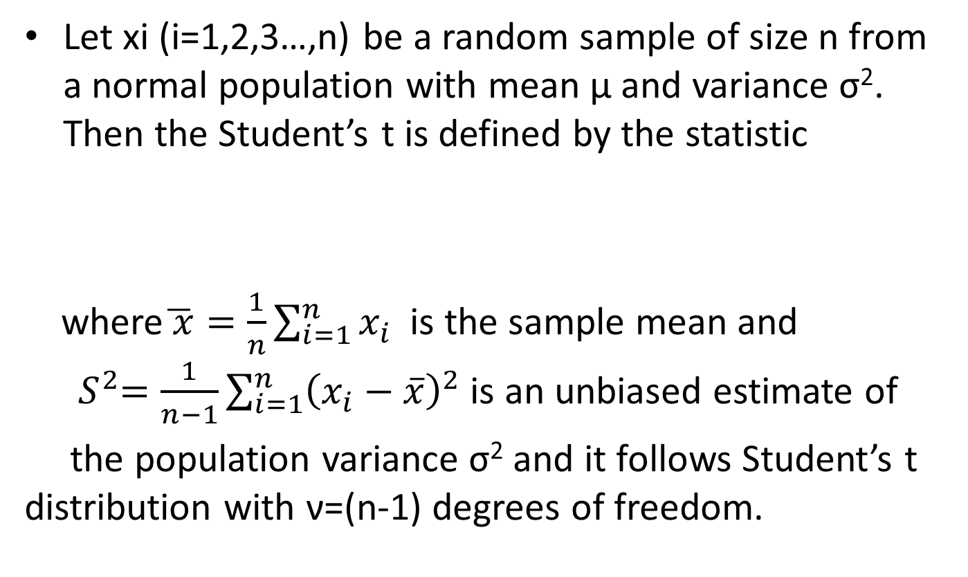
Student’s t distribution
Let xi (i=1,2,3…,n) be a random sample of size n from a normal population with mean μ and variance σ². Then the Student’s t is defined by the statistic
where$\overline{ x}=\frac{1}{n}\sum_{i=1}^{n}{x_{i }}$ is the sample mean and ${ S}^{2}=\frac{1}{n−1}\sum_{i=1}^{n}{{\left(x_{i}−\overline{x}\right)}^{2}}$ is an unbiased estimate of
the population variance σ² and it follows Student’s t distribution with ν=(n-1) degrees of freedom.
$$t=\frac{\overline{x}−μ}{\frac{s}{\sqrt{n}}}$$

Slide 5
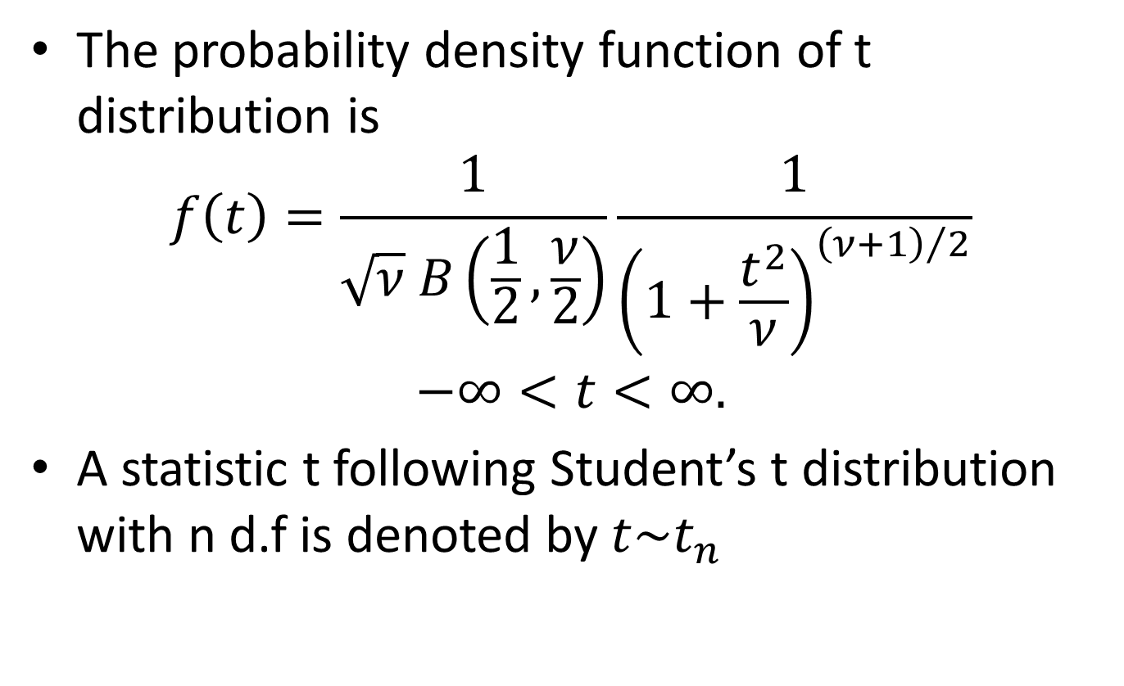
Student’s t distribution
The probability density function of t distribution is
$$f\left(t\right)=\frac{1}{\sqrt{ν} B\left(\frac{1}{2},\frac{ν}{2}\right)}\frac{1}{{\left(1+\frac{t^{2}}{ν}\right)}^{{\left(ν+1\right)}/2}}$$
$$−∞<t<∞.$$
A statistic t following Student’s t distribution with n d.f is denoted by $t\sim t_{n}$

Slide 6
Characteristics of t distribution
t statistic for estimating a population mean is relatively robust to the assumption that the population is normally distributed.
Like the standard normal curve, t distributions are symmetric, unimodal and a family of curves.
To find a value in the t distribution, requires knowing the degrees of freedom; each different value of degrees of freedom is associated with a different t distribution.
The term degrees of freedom(d.f.) refers to number of independent observations for a source of variation minus the number of independent parameters estimated in computing the variation.

Slide 7
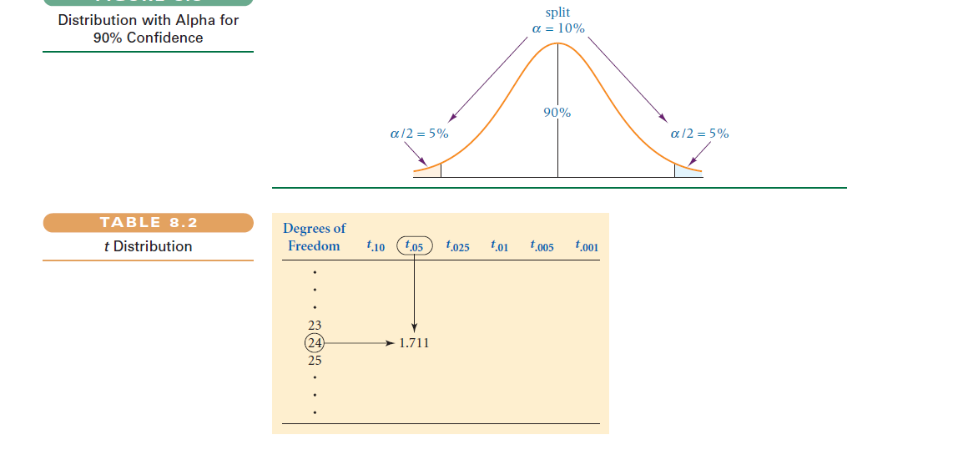
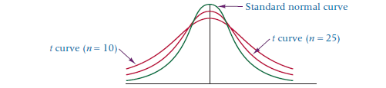
Reading t distribution table

Slide 8
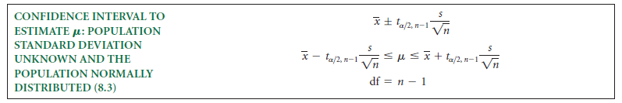
Estimating Population mean using t-statistic (C.I.Estimation)

Slide 9

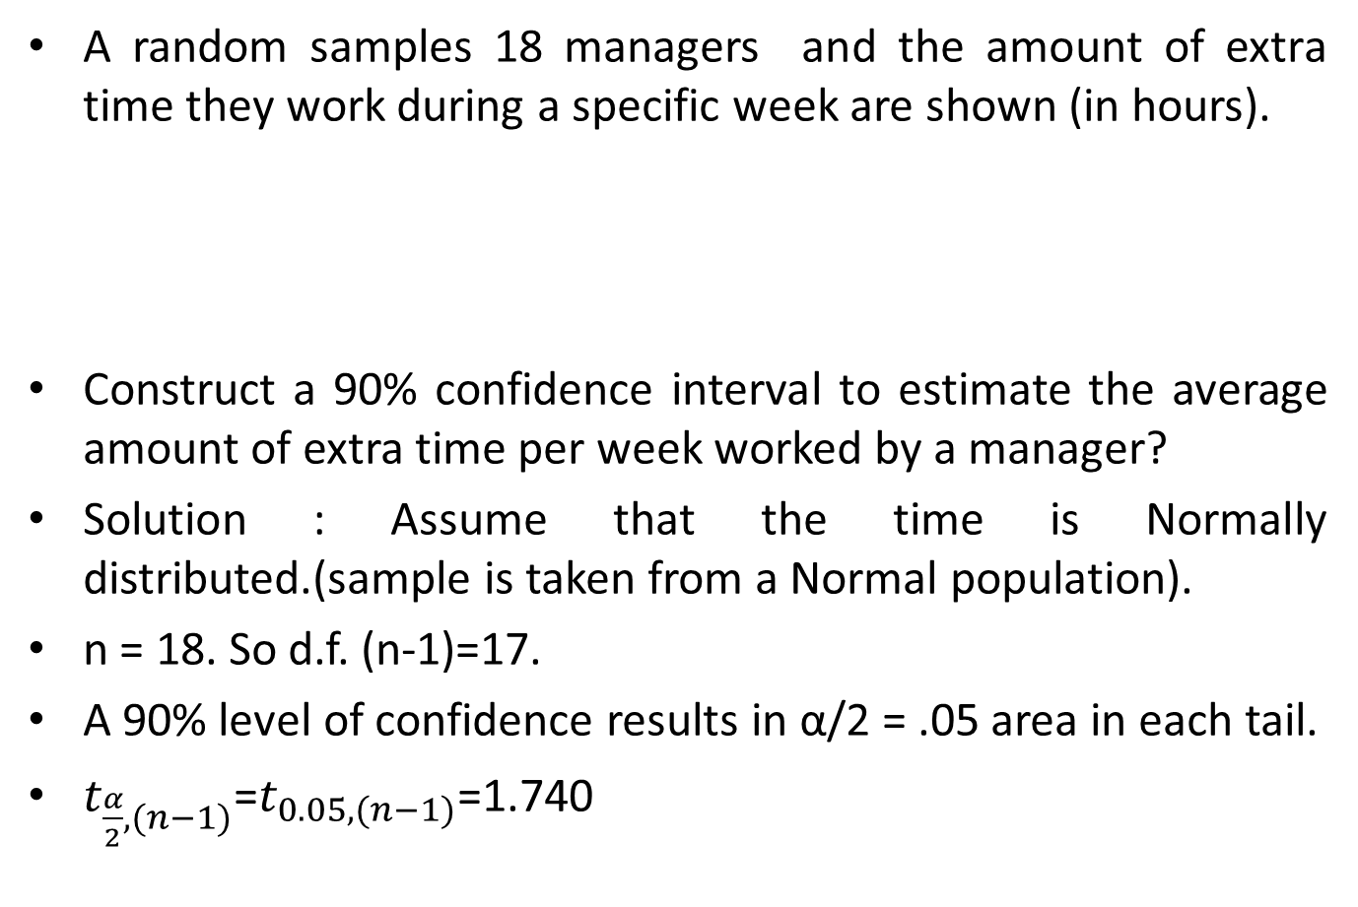
Example
A random samples 18 managers and the amount of extra time they work during a specific week are shown (in hours).
Construct a 90% confidence interval to estimate the average amount of extra time per week worked by a manager?
Solution : Assume that the time is Normally distributed.(sample is taken from a Normal population).
n = 18. So d.f. (n-1)=17.
A 90% level of confidence results in α/2 = .05 area in each tail.
$t_{\frac{α}{2},(n−1)}$=$t_{0.05,(n−1)}$=1.740

Slide 10
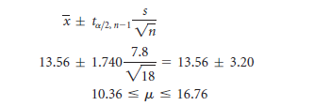
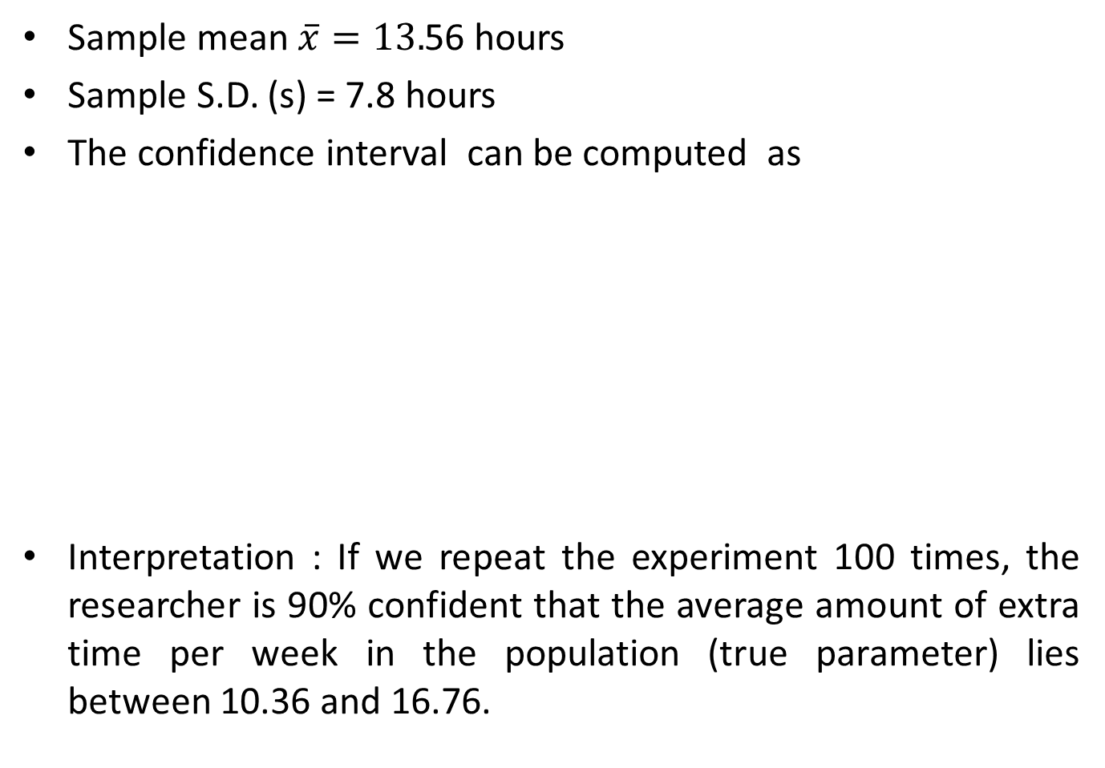
Sample mean $\overline{x}=13.$56 hours
Sample S.D. (s) = 7.8 hours
The confidence interval can be computed as
Interpretation : If we repeat the experiment 100 times, the researcher is 90% confident that the average amount of extra time per week in the population (true parameter) lies between 10.36 and 16.76.

Slide 11

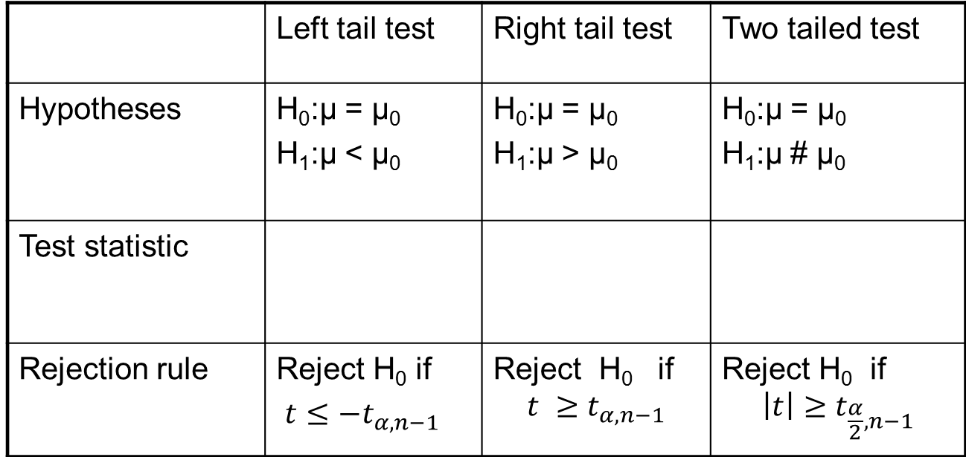



Test-2:Test for population mean μ : One sample t test (σ unknown and Population is Normally distributed )
 | Left tail test | Right tail test | Two tailed test
Hypotheses | H₀:μ = μ₀ H₁:μ < μ₀ | H₀:μ = μ₀ H₁:μ > μ₀ | H₀:μ = μ₀ H₁:μ # μ₀
Test statistic
Rejection rule | Reject H₀ if $t≤−t_{α,n−1}$ | Reject H₀ if $$t ≥t_{α,n−1}$$ | Reject H₀ if $$\left|t\right|≥t_{\frac{α}{2},n−1}$$
$$t=\frac{\overline{x}−μ_{0}}{\frac{s}{\sqrt{n}}}$$
$$t=\frac{\overline{x}−μ_{0}}{\frac{s}{\sqrt{n}}}$$
$$t=\frac{\overline{x}−μ_{0}}{\frac{s}{\sqrt{n}}}$$
$$t_{\frac{α}{2},n−1}$$
Where is the critical value obtained from the t distribution table

Slide 12
Example 1
Suppose that in past years the average price per square foot for warehouses in the United States has been $32.28. A national real estate investor wants to determine whether that figure has changed now. The investor hires a researcher who randomly samples 49 warehouses that are for sale across the United States and finds that the mean price per square foot is $31.67, with a standard deviation of $1.29. Assume that prices of warehouse footage are normally distributed in population. If the researcher uses a 5% level of significance, what statistical conclusion can be reached? What are the hypotheses?

Slide 13
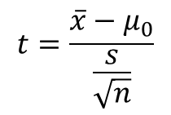
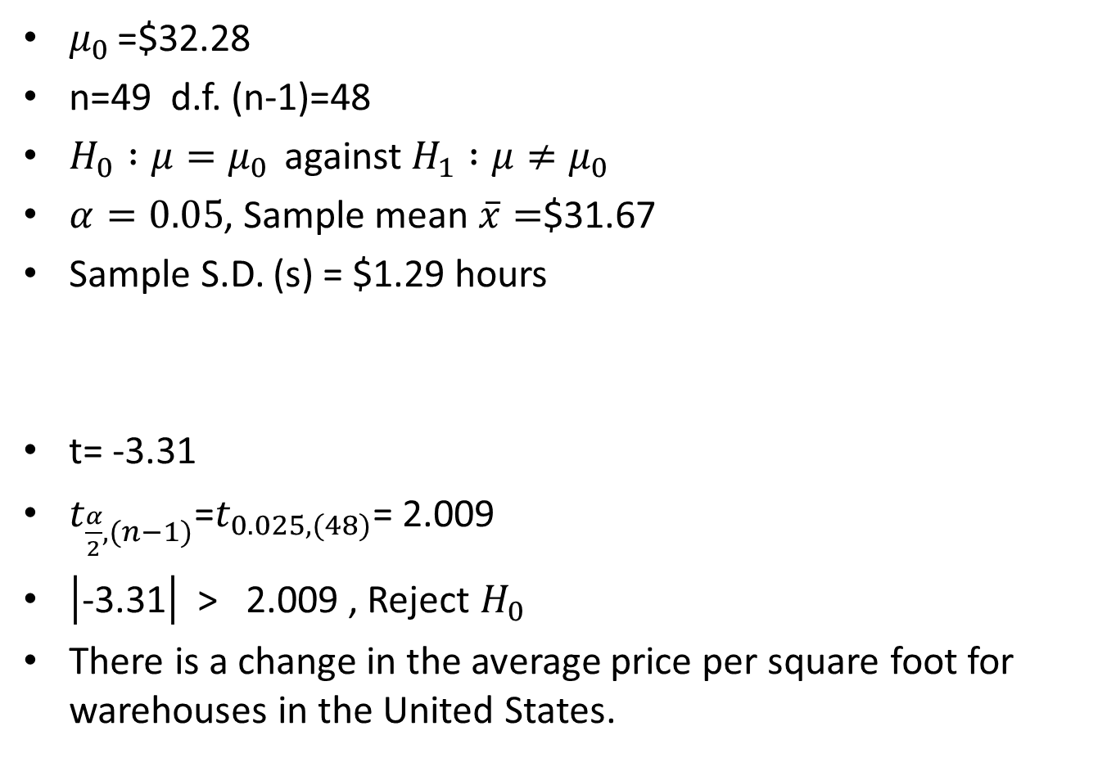
Solution
$μ_{0 }$=$32.28
n=49 d.f. (n-1)=48
$H_{0} :μ=μ_{0 }$ against $H_{1} :μ≠μ_{0 }$
$α=0.05$, Sample mean $\overline{x}=$$31.67
Sample S.D. (s) = $1.29 hours
t= -3.31
$t_{\frac{α}{2},(n−1)}$=$t_{0.025,(48)}$= 2.009
$\left|\text{−3.31}\right|$ > 2.009 , Reject $H_{0}$
There is a change in the average price per square foot for warehouses in the United States.
$$t=\frac{\overline{x}−μ_{0}}{\frac{s}{\sqrt{n}}}$$

